Slide 1

7th Grade Math
Unit 10, Lesson 10 Writing and Solving Equations in Real-World Context Volume 2, pg. 139

Slide 2


Benchmark
MA.7.AR.2.2
Write and solve two-step equations in one variable within a mathematical context or real-world context, where all terms are rational numbers.
volume 2, pg. 139

Slide 3
Integrated Mathematical Thinking and Reasoning Standards
MA.K12.MTR.1.1 Actively participate in effortful learning both individually and collectively.
MA.K12.MTR.3.1 Complete tasks with mathematical fluency.
MA.K12.MTR.4.1 Engage in discussions that reflect on the mathematical thinking of self and others.
MA.K12.MTR.5.1 Use patterns and structure to help understand and connect mathematical concepts.
MA.K12.MTR.6.1 Assess the reasonableness of solutions.
MA.K12.MTR.7.1 Apply mathematics to real-world contexts.
volume 2, pg. 139

Slide 4

Learning Targets
I can write two-step equations to represent real-world contexts.
I can solve two-step equations within a real-world context.
volume 2, pg. 139

Slide 5

Warm-Up
volume 2, pg. 140

Slide 6
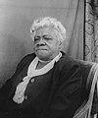
10.10.1 Warm-Up: Bell Work
Mary McLeod Bethune was an educator, civil rights activist, and advisor to five U.S. presidents. She turned her passion for the U.S. making racial progress into founding the Daytona Literacy and Industrial Training School for Negro Girls in 1904. Twenty years later, the school would merge with Cookman Institute of Jacksonville to create what is known today as Bethune-Cookman University, a Historically Black College University (HBCU). Mary McLeod Bethune was president of the university until 1942.
volume 2, pg. 140

Slide 7
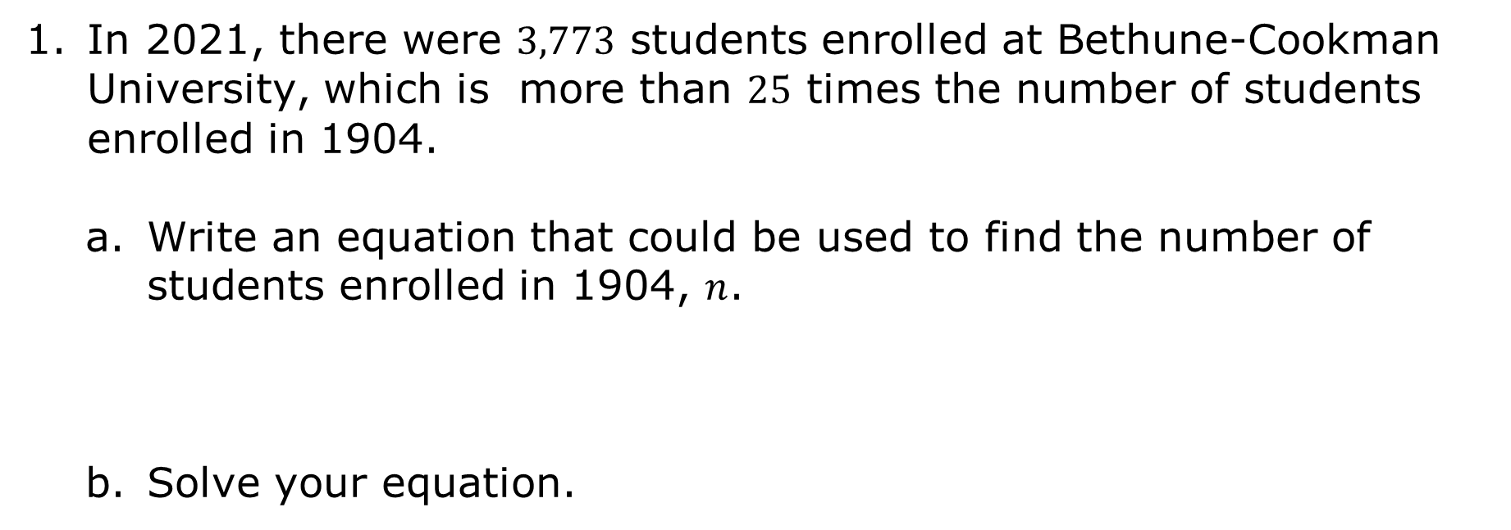
In 2021, there were $3,773$ students enrolled at Bethune-Cookman University, which is more than $25$ times the number of students enrolled in 1904.
Write an equation that could be used to find the number of students enrolled in 1904, $n$.
Solve your equation.
volume 2, pg. 140

Slide 8

Collaboration
volume 2, pg. 140

Slide 9

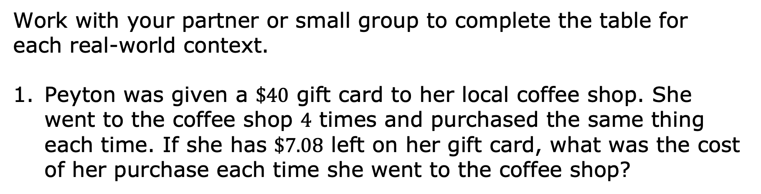
10.10.2 Collaboration: Writing and Solving Equations in Real-World Contexts
Work with your partner or small group to complete the table for each real-world context.
Peyton was given a $\$40$ gift card to her local coffee shop. She went to the coffee shop $4$ times and purchased the same thing each time. If she has $\$7.08$ left on her gift card, what was the cost of her purchase each time she went to the coffee shop?
volume 2, pg. 140

Slide 10
Define the variable.
Write an equation that can be used to answer the question.
Solve the equation.
Explain the meaning of the solution.
volume 2, pg. 140

Slide 11
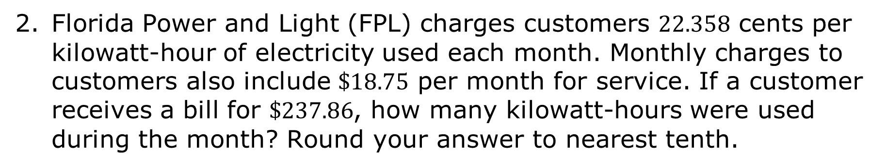
Florida Power and Light (FPL) charges customers $22.358$ cents per kilowatt-hour of electricity used each month. Monthly charges to customers also include $\$18.75$ per month for service. If a customer receives a bill for $\$237.86$, how many kilowatt-hours were used during the month? Round your answer to nearest tenth.
Define the variable.
Write an equation that can be used to answer the question.
volume 2, pg. 141

Slide 12
Solve the equation.
Explain the meaning of the solution.
volume 2, pg. 141

Slide 13
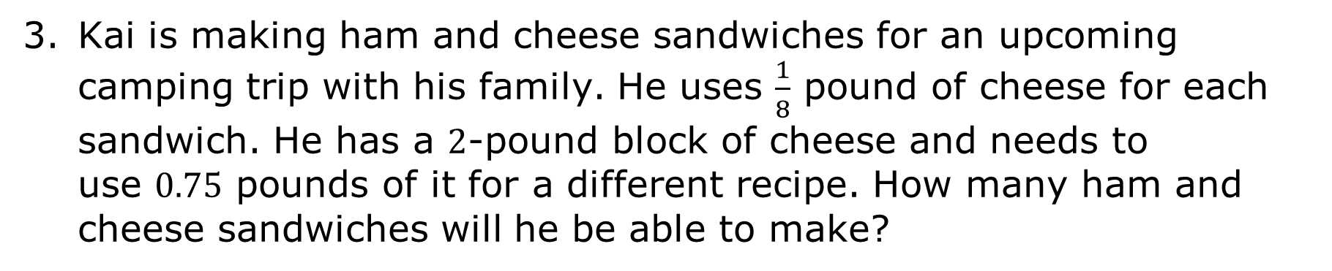
Kai is making ham and cheese sandwiches for an upcoming camping trip with his family. He uses $\frac{1}{8}$ pound of cheese for each sandwich. He has a $2$-pound block of cheese and needs to use $0.75$ pounds of it for a different recipe. How many ham and cheese sandwiches will he be able to make?
Define the variable.
Write an equation that can be used to answer the question.
volume 2, pg. 141

Slide 14
Solve the equation.
Explain the meaning of the solution.
volume 2, pg. 141

Slide 15
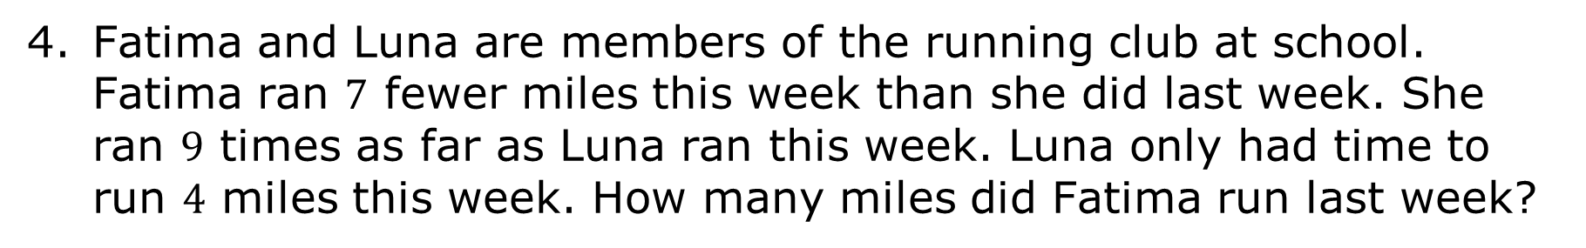
Fatima and Luna are members of the running club at school. Fatima ran $7$ fewer miles this week than she did last week. She ran $9$ times as far as Luna ran this week. Luna only had time to run $4$ miles this week. How many miles did Fatima run last week?
Define the variable.
Write an equation that can be used to answer the question.
volume 2, pg. 142

Slide 16
Solve the equation.
Explain the meaning of the solution.
volume 2, pg. 142

Slide 17
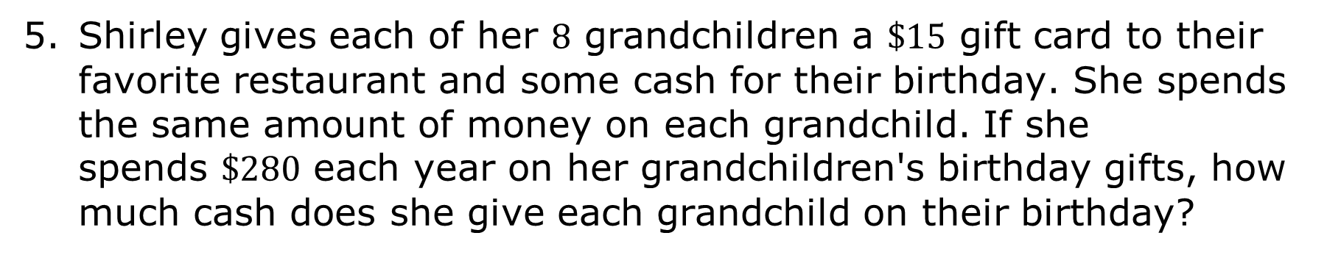
Shirley gives each of her $8$ grandchildren a $\$15$ gift card to their favorite restaurant and some cash for their birthday. She spends the same amount of money on each grandchild. If she spends $\$280$ each year on her grandchildren's birthday gifts, how much cash does she give each grandchild on their birthday?
Define the variable.
Write an equation that can be used to answer the question.
volume 2, pg. 142

Slide 18
Solve the equation.
Explain the meaning of the solution.
volume 2, pg. 142

Slide 19

Bring It Together
volume 2, pg. 143

Slide 20
10.10.3 Bring It Together: Writing and Solving Equations in Real-World Contexts
Consider some of the problems you’ve solved and errors you’ve made over the last few lessons.
In the first column of the table, write yourself a note or reminder that you can use when writing an equation for a real-world context so you can avoid similar errors in the future.
My Note or Reminders | My Partner’s Reminders
volume 2, pg. 143

Slide 21
Share your list with your partner. Add any helpful reminders your partner shares in the second column.
volume 2, pg. 143

Slide 22

Your Turn
volume 2, pg. 143

Slide 23
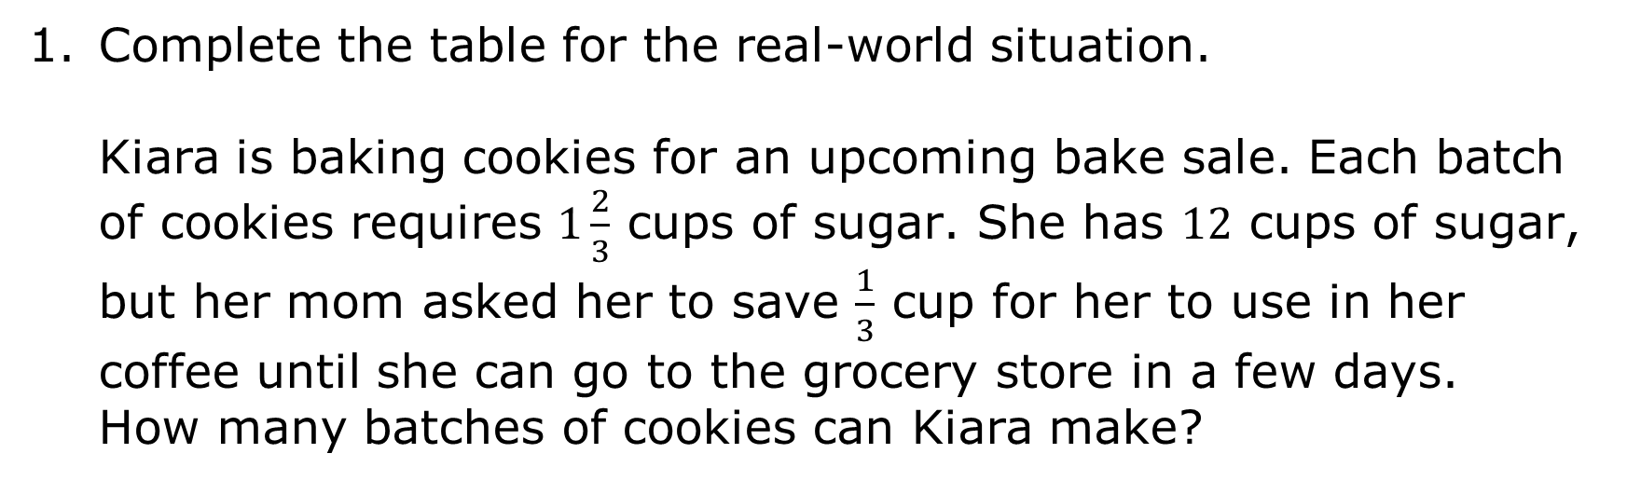
10.10.4 Your Turn!
Complete the table for the real-world situation. Kiara is baking cookies for an upcoming bake sale. Each batch of cookies requires $1\frac{2}{3}$ cups of sugar. She has $12$ cups of sugar, but her mom asked her to save $\frac{1}{3}$ cup for her to use in her coffee until she can go to the grocery store in a few days. How many batches of cookies can Kiara make?
volume 2, pg. 143

Slide 24
Define the variable.
Write an equation that can be used to answer the question.
Solve the equation.
Explain the meaning of the solution.
volume 2, pg. 143

Slide 25

Wrap-Up
volume 2, pg. 144

Slide 26



10.10.5 Wrap-Up: Reflection
Circle the icon that best describes your understanding of each item.
I could help someone.
I need help.
I got it.
Solving two-step equations
Writing two-step equations to represent real-world contexts
Explaining the meaning of solutions to equations in context
volume 2, pg. 144

